Slide 1
Chapter 32
Electromagnetic Waves

Slide 2
LIGHT is an electromagnetic wave
Maxwell’s Equations–Electricity and Magnetism –> electromagnetic waves move at the speed of light.
B = ε₀μ₀cE and Max. Eqns. → c = 1/√(ε₀μ₀), a fact which Hertz tested experimentally a few decades after Maxwell derived it. Therefore, light is an electromagnetic wave, from the classic viewpoint.
Maxwell’s Wave Equation:
∂²E(x,t)/∂x² = ε₀μ₀∂²E(x,t)/∂t²
∂²B(y,t)/∂x² = ε₀μ₀ ∂²B(y,t)/∂t²
Wave functions: E(x,t) = E₀sin(ωt-kx)
and B(x,t) = B₀sin(ωt-kx).

Slide 3
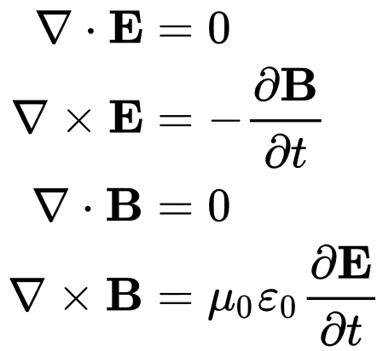
PROOF: First step to derive Maxwell’s wave equations--Heavyside’s version of Maxwell’s Equations. Charge and current are set to zero.

Slide 4
The curl of the equations results in:

Slide 5
We can use the vector identity
Where V is any vector function of space, and

Slide 6
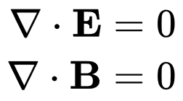
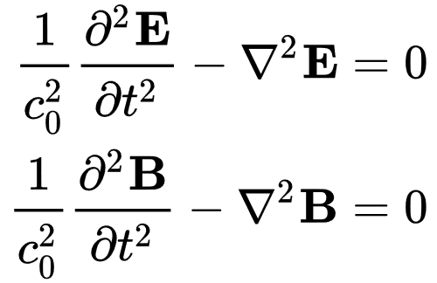
∇
V is a dyadic which when operated on by the divergence operator ∇ ⋅ yields a vector. Since
then the first term on the right in the identity vanishes and we obtain the wave equations:
where

Slide 7
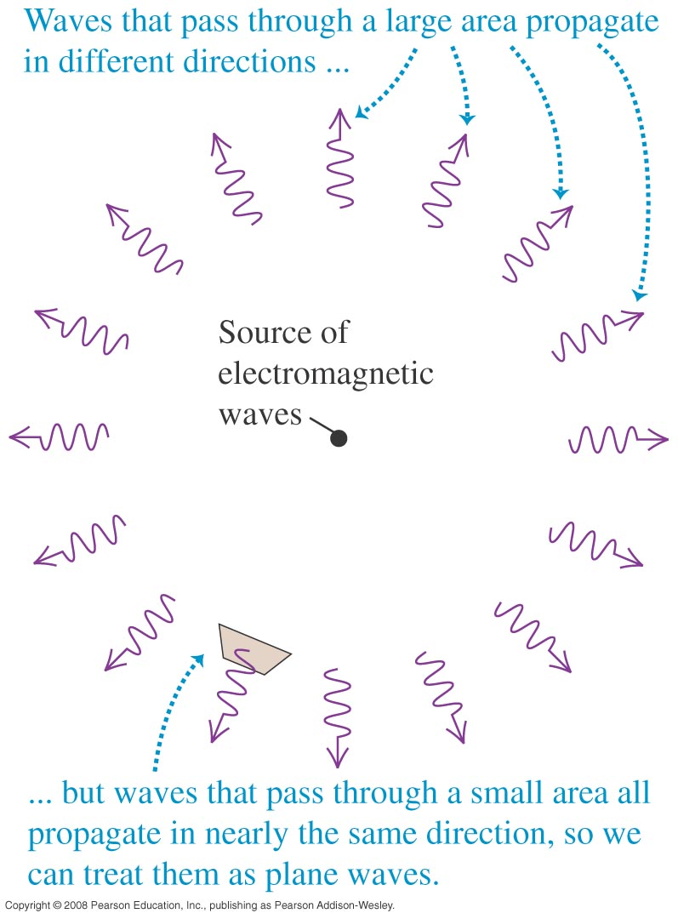
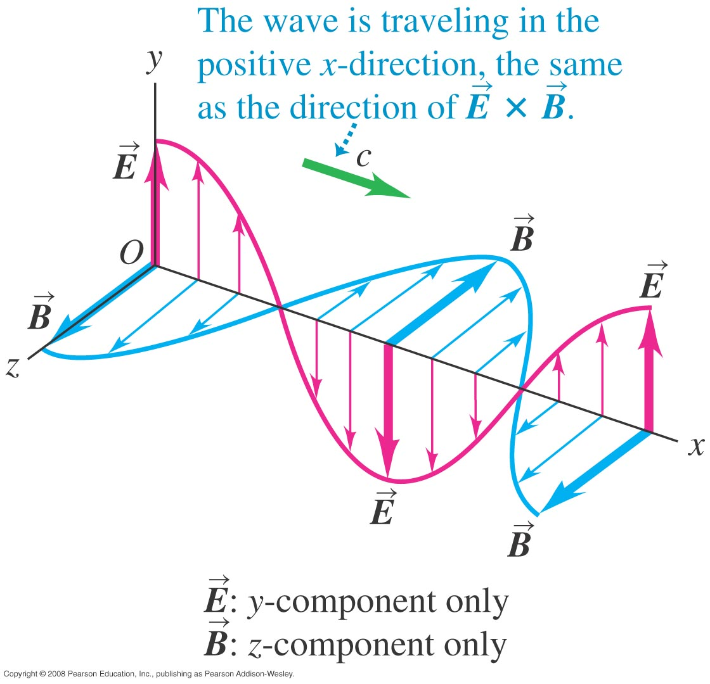
Electromagnetic waves may be treated as plane waves
Far enough from the source and considering one polarization of the vector planes only, the representations of electric and magnetic fields may be treated as orthogonal and sinusoidal waves.
Read Problem-Solving Strategy 32.1.
Consider Figures 32.12 and 32.13 below. HERTZ FORMAT:

Slide 8
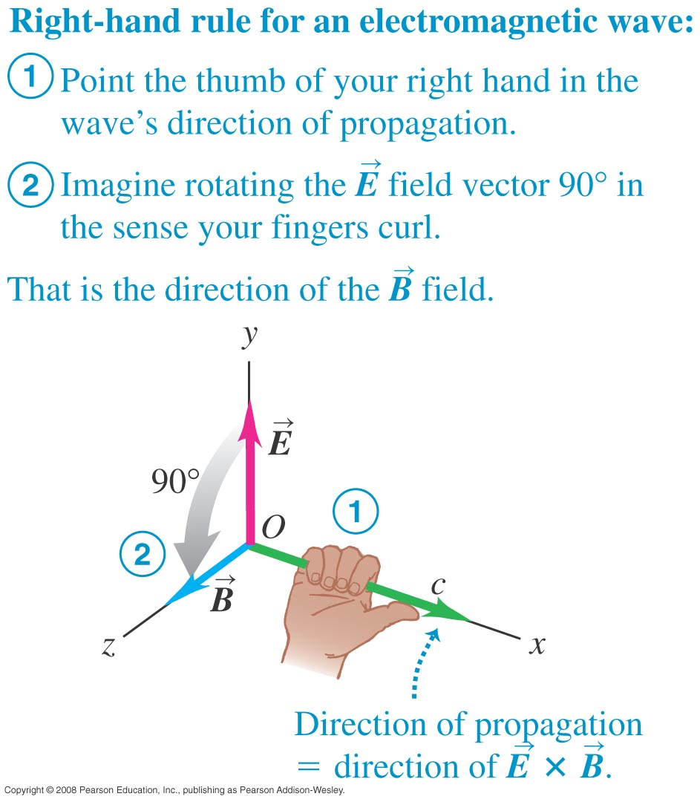
Propagation of electromagnetic waves
The wave is transverse, moving at unchanging c in a vacuum, with electric and magnetic fields in a definite ratio, and requiring no medium (like water or air). The right-hand rule applies—see Figure 32.9 below.

Slide 9
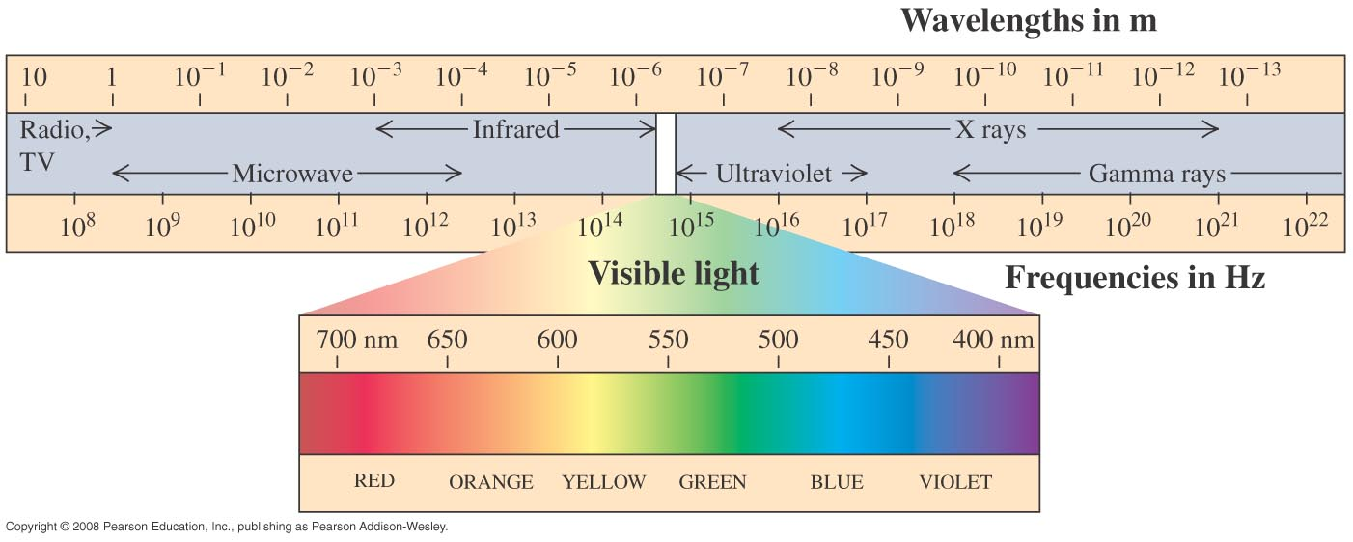
Electromagnetic waves occur over a wide range
Where wavelength is large, frequency is small.
The range extends from low energy and frequency (radio and television) to high energy and small wavelength (gamma rays).

Slide 10
Not all light is visible. The electromagnetic spectrum: Radio Microwave Infrared Visible Ultraviolet X-Rays Gamma Rays -----------------------------------------------------------> Energy, frequency (E = hf) Wavelength λ = c/f <-------------------------------------------- A nanometer is a billionth of a meter. Visible light has a range of 400-700 nanometers. The speed of light in a vacuum or air is c = 186,000 mi/s = 3.0 x 10⁸ m/s.

Slide 11
Power: P = loop∫S∙dA, where S = (1/μ₀) E X B, Poynting Vector. Average S is called the Intensity, I = E₀B₀/2μ₀ . Radiation pressure: p = I/c, for absorbed, 2I/c for reflected. Electromagnetic waves (if contained) can be standing waves for E and B like waves on a rope. E and B are represented in the Hertz format as perpendicular, and this light is a transverse wave. However, Nicola Tesla claimed that it could be represented as a longitudinal wave, and this is also true mathematically (though almost never considered because light has no medium like sound—unless somehow the dark energy in space enters in).

Slide 12
Transparent materials allow light to be passed on by vibrating electrons. A chain of absorptions and re-emissions occurs. This slows the passage of light and the speed of light is thus smaller in a dense medium. Opaque materials absorb all the light, turning it into random kinetic energy. Metals are opaque because their free electrons dissipate order by colliding. The eye involves an adjustable lens which focuses an inverted image on the retina. The brain makes the image erect. Rods record black and white, and cones color.

Slide 13
The color of an object results from selective reflection. The sky is blue because of preferential scattering of blue light. c = f λ --The light (and wave) velocity formula.

Slide 14
Chapter 33
The Nature and Propagation of Light

Slide 15
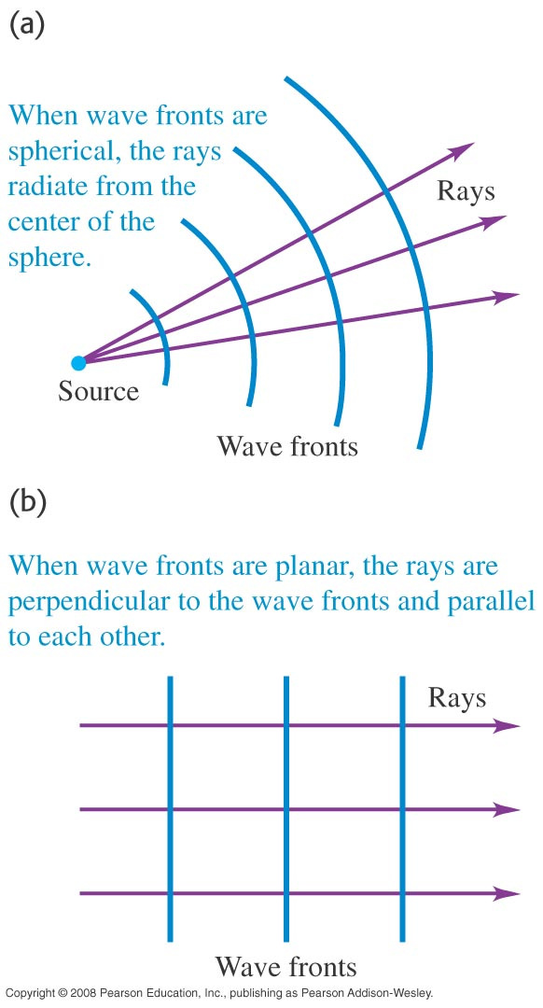
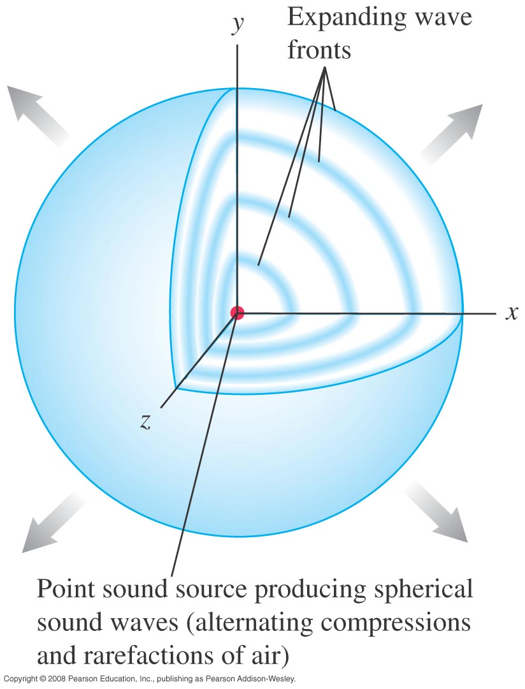
Wave fronts and rays
Light is actually a nearly uncountable number of electromagnetic wave fronts, but analysis of refraction or reflection are made possible by treating light as a ray.

Slide 16
Optics Reflection and Refraction Geometric optics assumes light can be represented by rays, ignoring interference. This is for wavelength λ << size of optical components. Reflection occurs from surfaces whose electrons are free to oscillate along the surface and re-emit the light. That’s why metals are shiny and mirrors are silvered. The law of Reflection: the angle of incidence = the angle of reflection. (diagram on next page) These angles are measured for the incident and reflected ray of light relative to a line perpendicular to the surface called the normal.

Slide 17
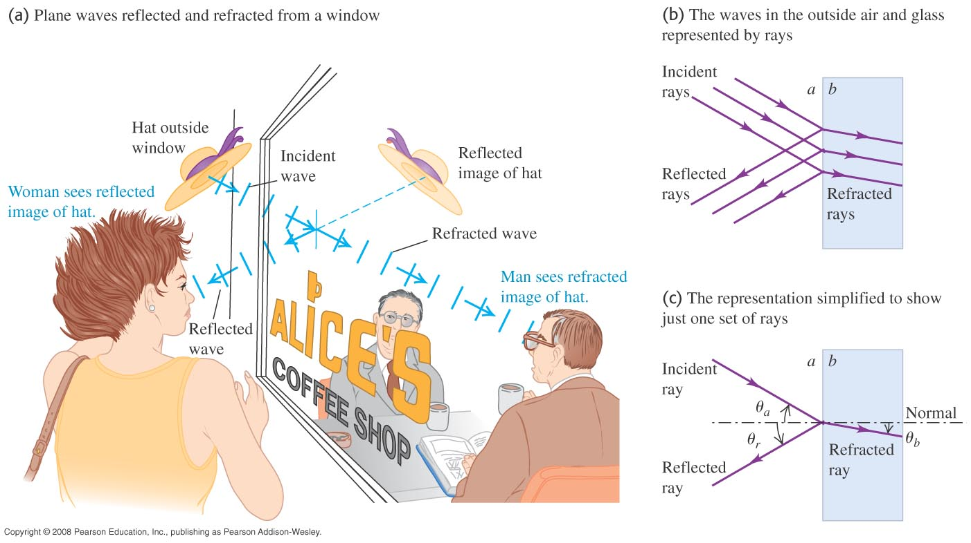
Reflection and refraction
Figure 33.5 illustrates both reflection and refraction at once. The storefront window both shows the passersby their reflections and allows them to see inside.

Slide 18
Flat mirrors create virtual images. These images are not formed by light, but appear to be extensions of reflected rays. Real images are formed by actual light rays. They are formed by concave mirrors as in a Newtonian telescope. Refraction is the bending of light as it enters a new material at an angle to the normal. The change in speed of light is causing the effect. The index of refraction is n = c/v, where v is the speed of light in the medium. Snell’s Law gives the relation between the incident and refracted angles between two media: n₁sinθ₁ = n₂sinθ₂. However, the wavelength of light in a material is λ = λ₀/n.

Slide 19
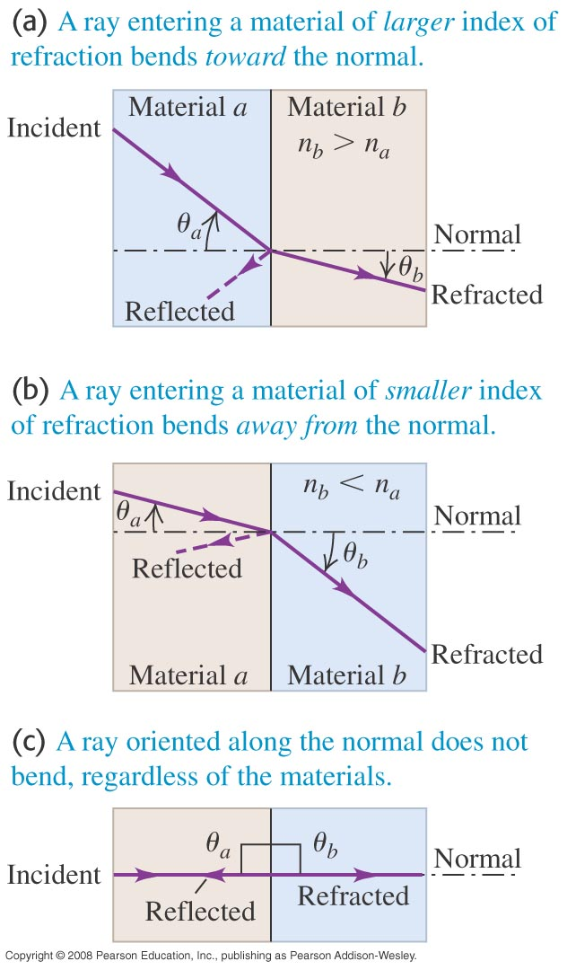
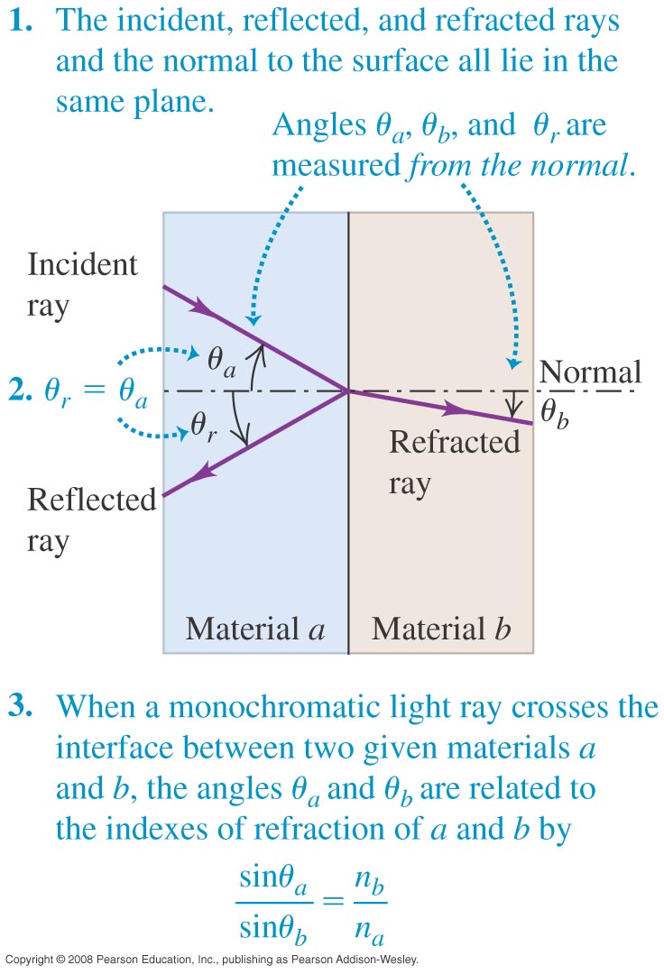
Laws of reflection and refraction
Angle of incidence = angle of reflection.
Snell’s Law of Refraction considers the slowing of light in a medium other than vacuum … the index of refraction.
Consider Figures 33.7 and 33.8.

Slide 20
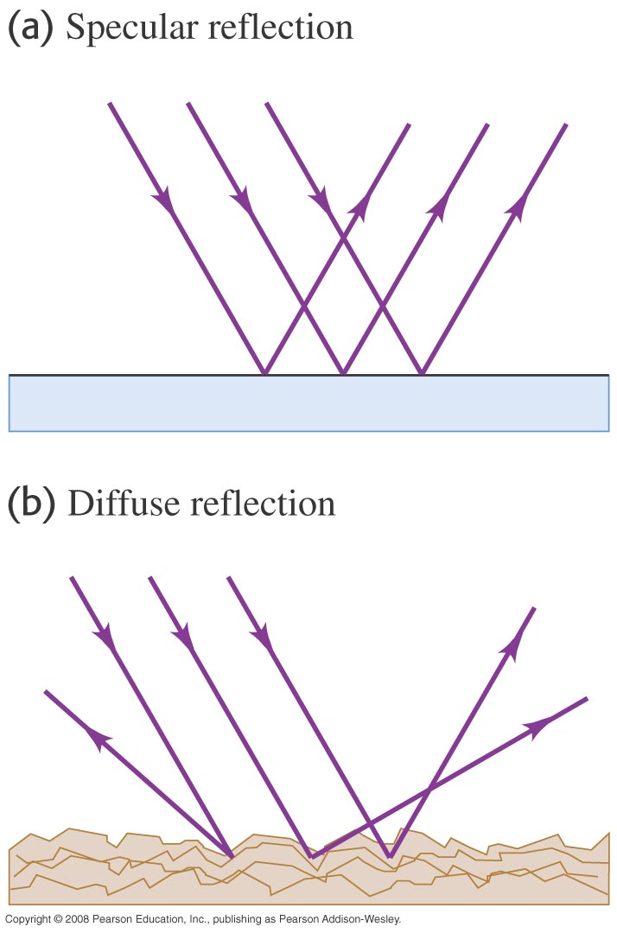
We will consider specular reflections
A real surface will scatter and reflect light. Diffuse reflection is the rule, not the exception. We will use specular reflection as we used the ray approximation, to make a very difficult problem manageable.
Consider Figure 33.6.

Slide 21
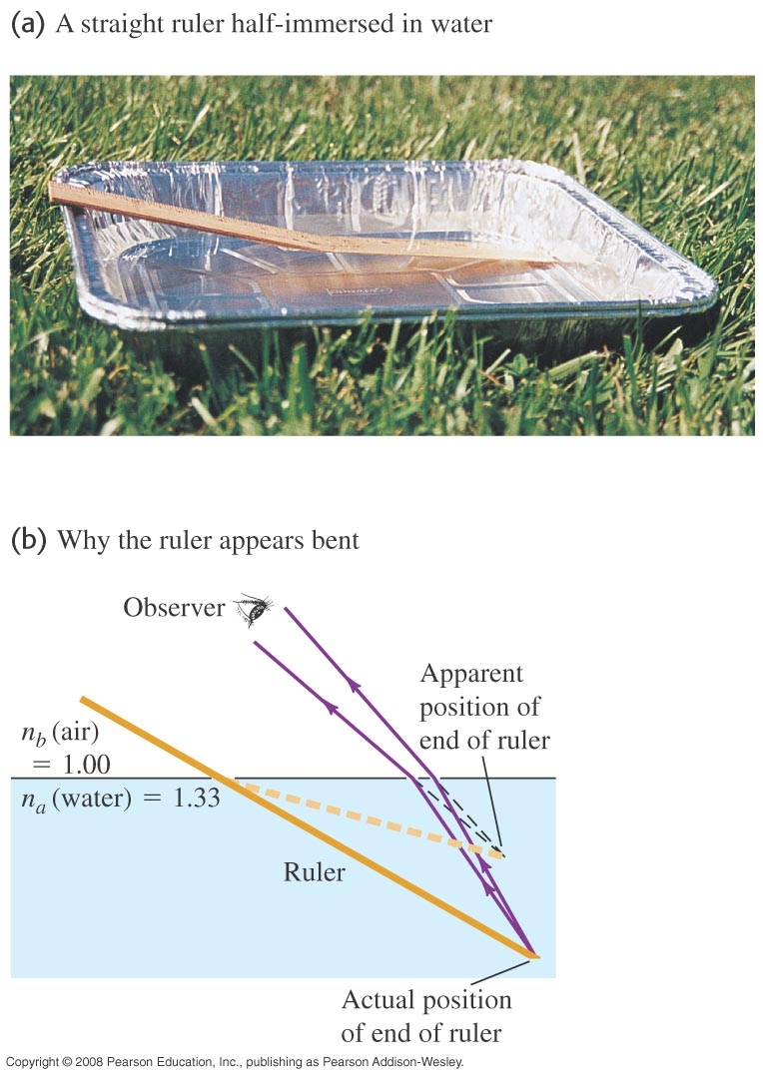
Why should the ruler appear to be bent?
The difference in index of refraction for air and water causes your eye to be deceived. Your brain follows rays back to the origin they would have had if not bent.
Consider Figure 33.9.

Slide 22
Total Internal reflection: the critical angle is for sinΘ_{crit} = n₂/ n₁ (see next slide). There is a critical angle for refraction beyond which no light goes into the second medium–it is all reflected. This happens in fiber optics. Dispersion: n= n(λ) . For a given medium, n varies slightly with λ. This is what disperses the light from the sun going through a prism.

Slide 23
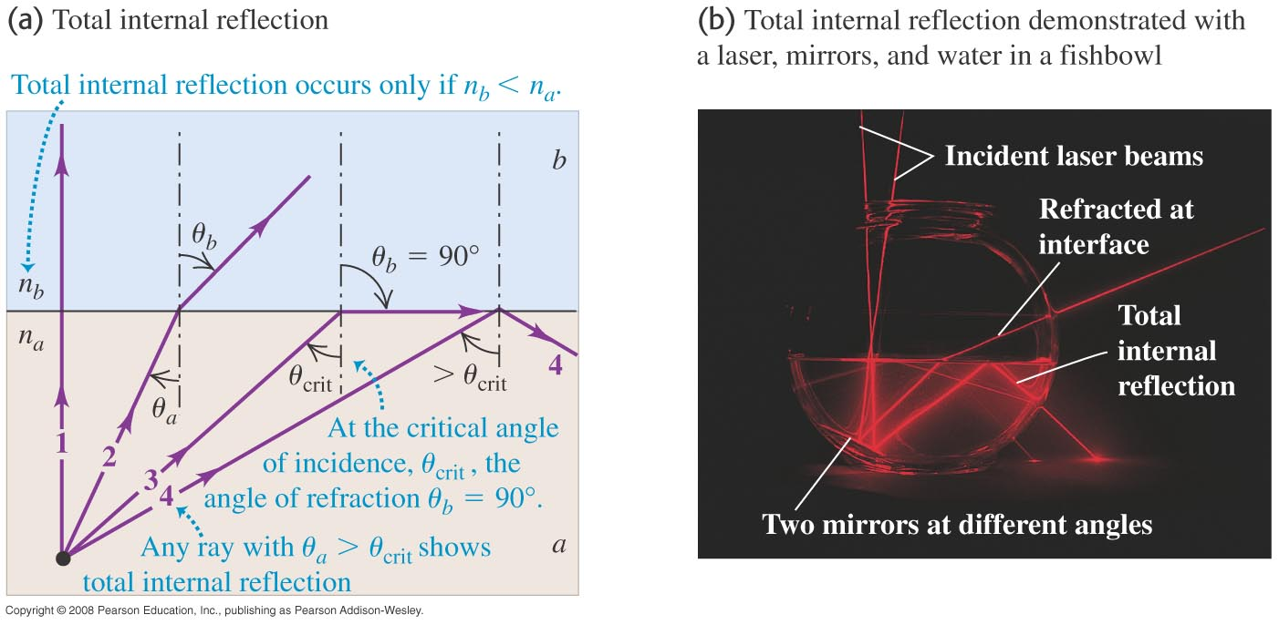
Total internal reflection I
As the angle of incidence becomes more and more acute, the light ceases to be transmitted, only reflected.
Consider Figure 33.13.

Slide 24
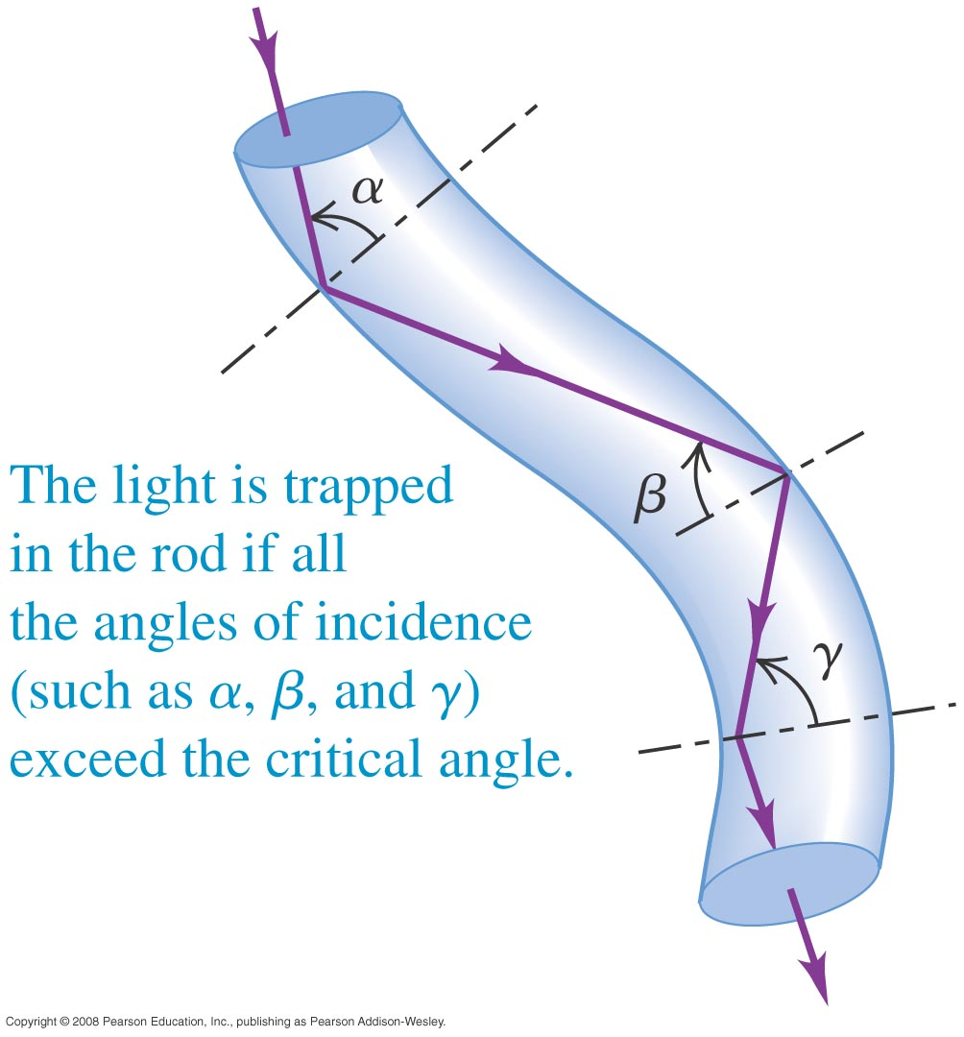
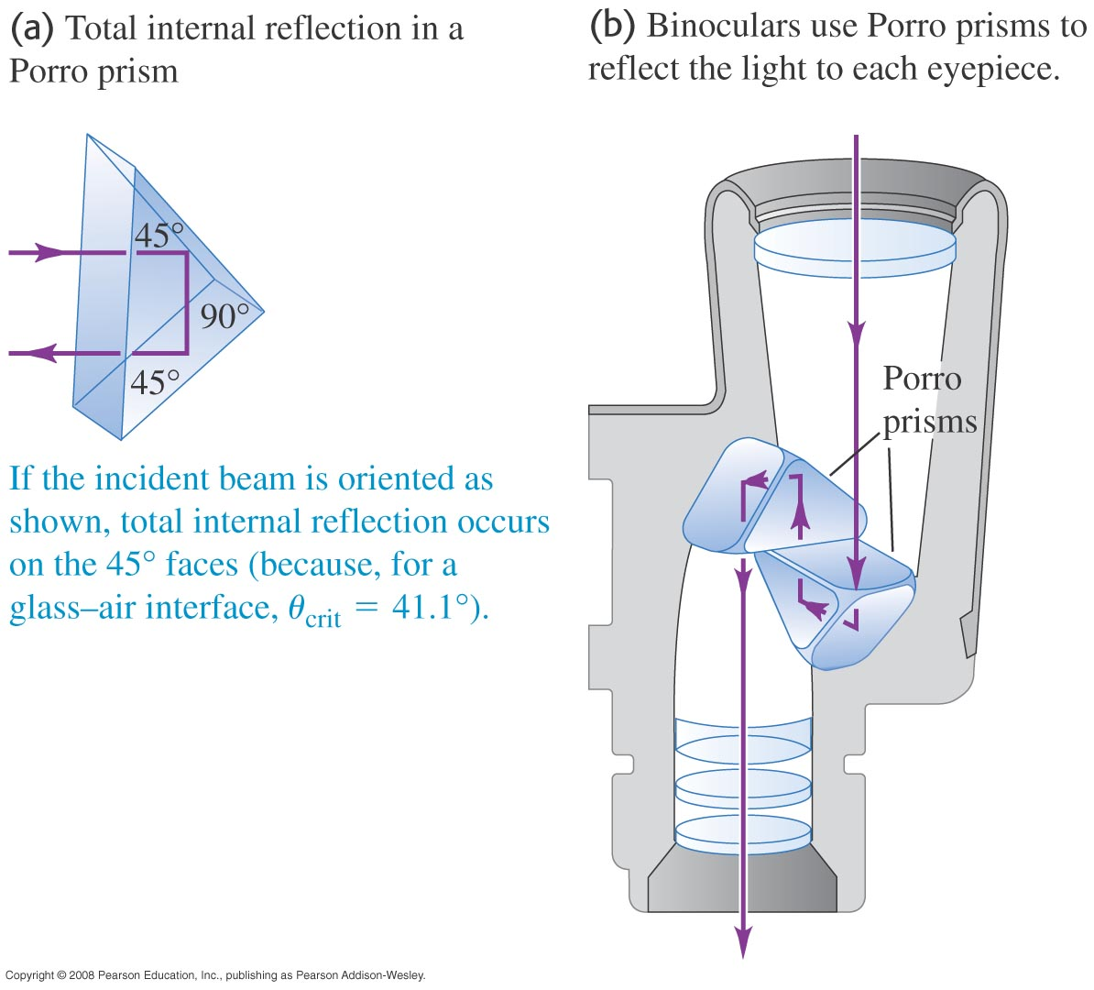
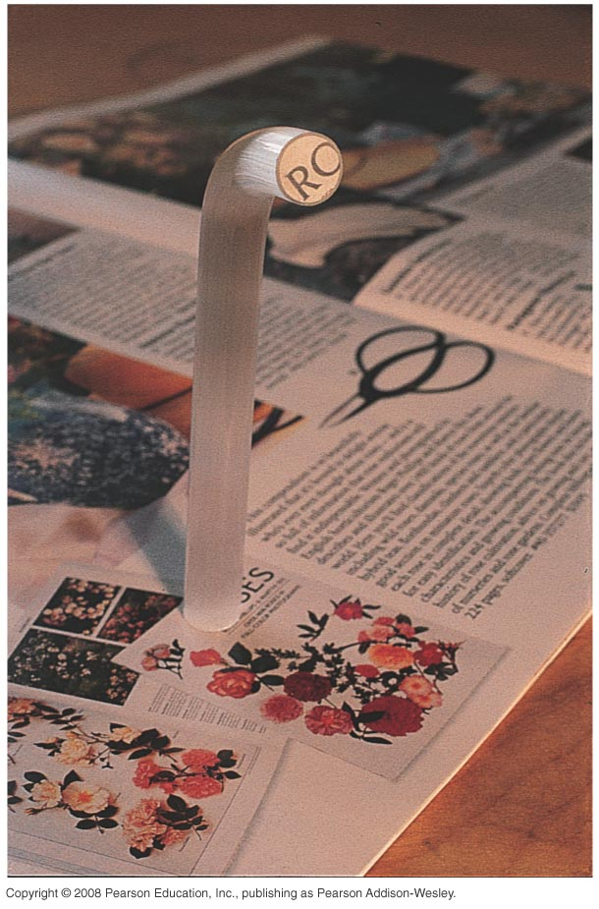
Total internal reflection II
Using clever arrangements of glass or plastic, the applications are mind boggling.

Slide 25
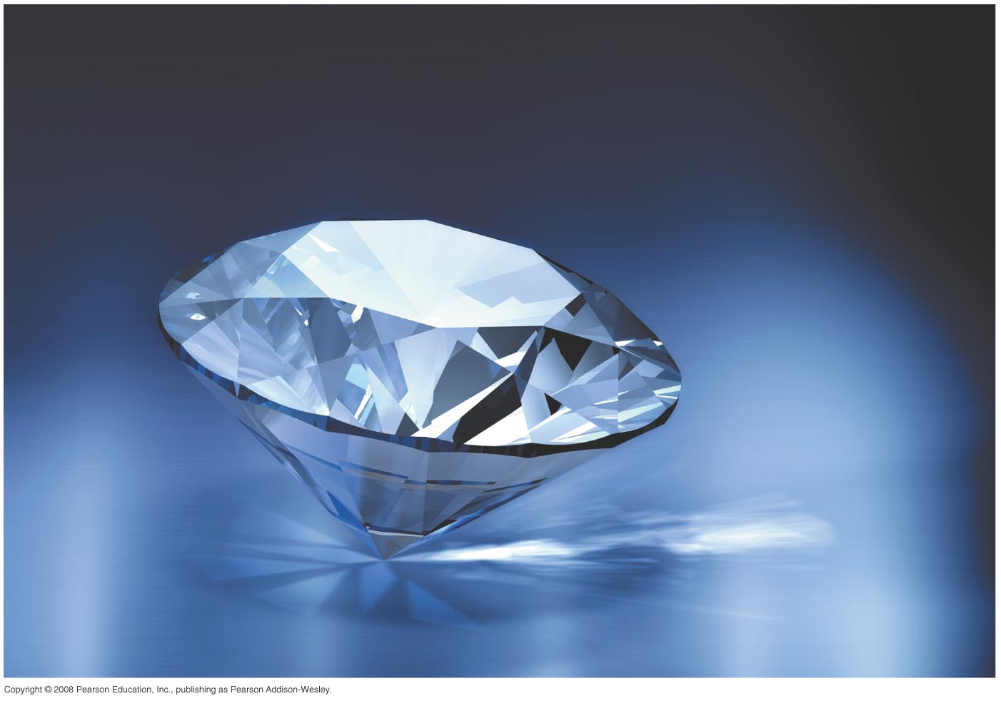
Total internal reflection III
Diamonds sparkle as they do because their index of refraction is one of the highest a transparent material can have. Nearly all light that enters a surface ends up making many passes around the inside of the stone. The effect is only amplified by cutting the surfaces at sharp angles. See Figure 33.17.
Follow Conceptual Example 33.4.

Slide 26
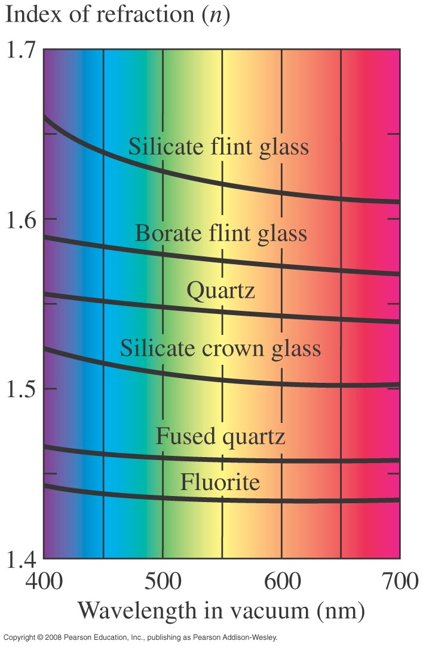
Dispersion
From the discussion of the prism seen in earlier slides, we recall that light refraction is wavelength dependent. This effect is made more pronounced if the index of refraction is higher. “Making a rainbow” is actually more than just appreciation of beauty; applied to chemical systems, the dispersion of spectral lines can be a powerful identification tool.
Refer to Figures 33.18 and 33.19 (not shown).

Slide 27
Polarization—the direction of the Electric field of photons. For going through a linear polarizer, randomly polarized light is diminished in intensity I → I/2, where I is proportional to E². Linearly polarized light is diminished by I₀ → I = I₀cos²Θ, the Law of Malus. Polarization by reflection: light reflected at a surface is completely polarized at the polarization (Brewster) angle, Θ_{p} = tan⁻¹(n₂/ n₁). Critical angle involves sin, polarization involves tan, same formula otherwise. Circular and elliptical polarization involves a rotating E field.

Slide 28
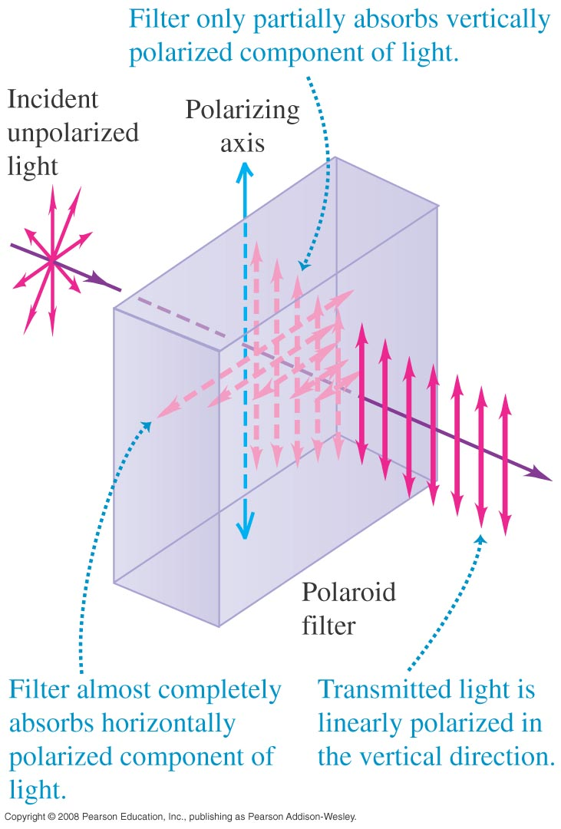
Selecting one orientation of the EM wave—the Polaroid
A Polaroid filter is a polymer array that can be thought of like teeth in a comb. Hold the comb at arm’s length with the teeth pointing down. Continue the mental cartoon and imagine waves oscillating straight up and down passing without resistance. Any “side-to-side” component and they would be blocked.

Slide 29
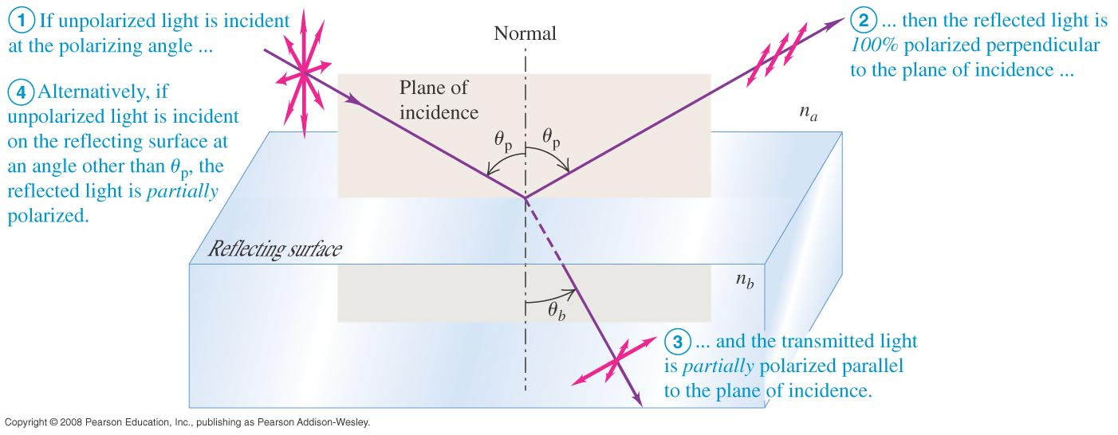
Polarization I
Read Problem-Solving Strategy 33.2.
Follow Example 33.5.
By reflection from a surface? Read pages 1139 and 1140 and then refer to Figure 33.27 below.

Slide 30
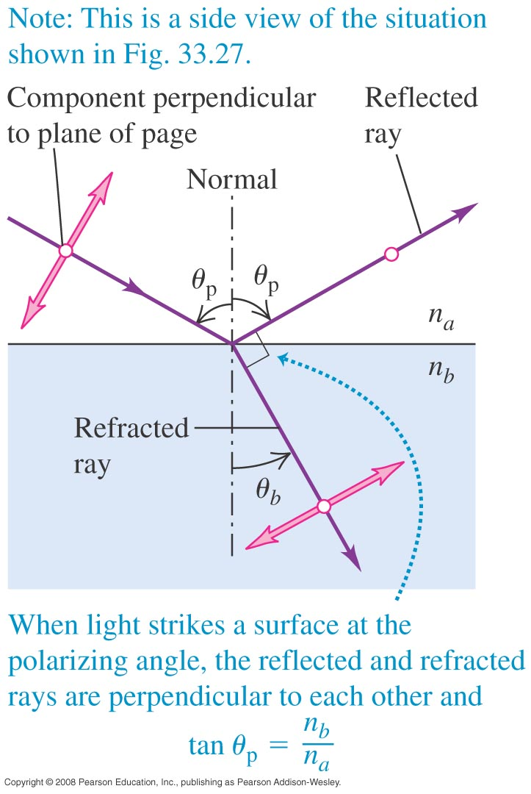
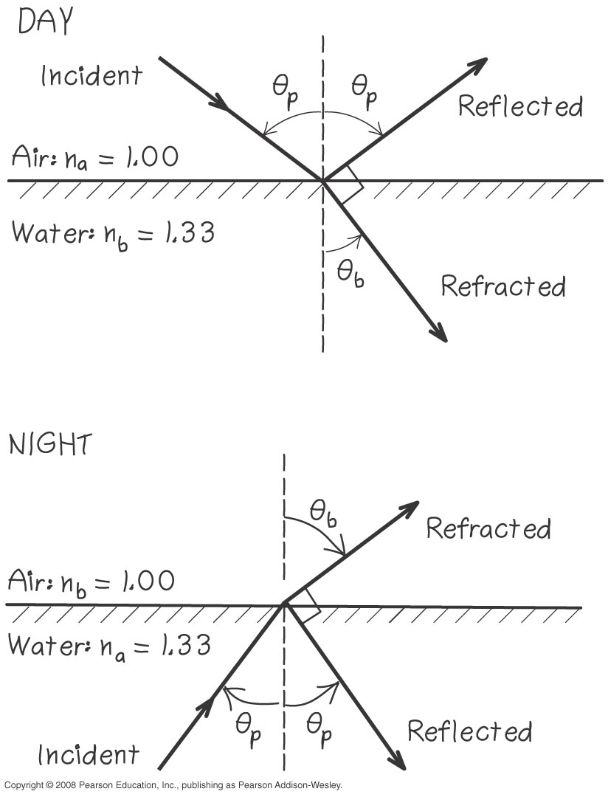
Polarization II
Consider Figure 33.28.
Follow Example 33.6, illustrated by Figure 33.29.

Slide 31
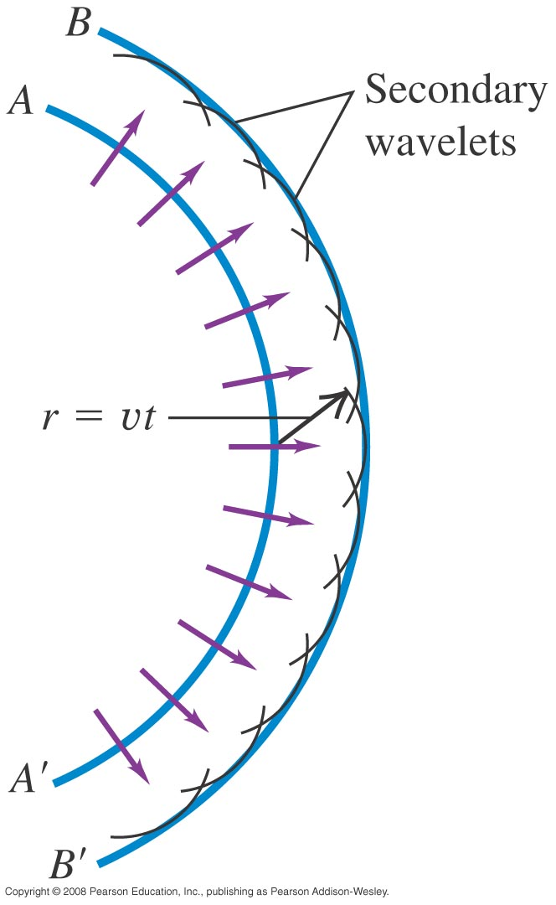
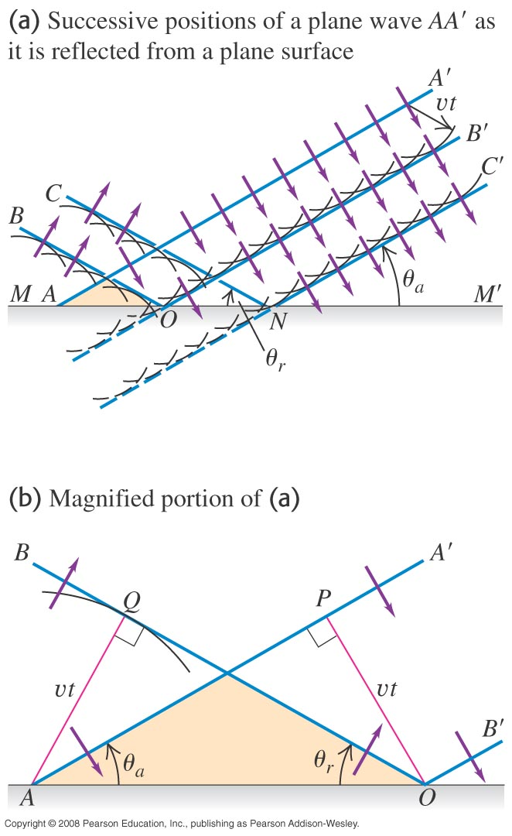
Huygens’s Principle
From the work of Christian Huygens in 1678, the geometrical analysis reveals that every point of a wave front can be considered to be a source of secondary wavelets that spread with a speed equal to the speed of propagation of the wave.
Consider Figures 33.34 and 33.35.

Slide 32
Huygens’s Principle II
Huygens’s work can form an explanation of reflection and refraction.
Refer to Figures 33.36 and 33.37.

